Slide 1
Final Project
Flanco.ro
Adrian Ianc

Slide 2

Flanco.ro is an online store that offers a wide range of products, including electronics, mobile phones, home and garden products, toys, personal care products, pet supplies, and more. Users can easily navigate through product categories and perform specific searches to find desired products.
Each product has a detailed presentation page, including photos, complete descriptions, and customer reviews.
Users can add desired products to the shopping cart and complete the order by paying online or upon delivery. The website also offers the option to check the availability of products in physical stores.
In summary, Flanco.ro is a useful and user-friendly application that offers a variety of products and services tailored to the needs of its customers.

Slide 3

Make a plan
As a tester and also a user, I approached testing for Flanco.ro by focusing on the most critical functionalities that an online store should provide, such as product search, adding products to the cart, checking out, and payment processing.
I used positive and negative test scenarios and exploratory testing techniques to ensure that the website met the users' requirements and expectations.

Slide 4

Tools
Tools :
I used macOS operating system and Safari browser for exploring the application.
As for the test cases, I used the TestLink platform to write and execute them, and the bugs found were reported in the Mantis platform.

Slide 5
Testing types covered
I covered several testing types during your project, including smoke testing and exploratory testing.
Smoke testing involves testing the functionality of the application to ensure it meets the specified requirements. Negative testing involves intentionally testing the application with invalid or unexpected inputs to check if it handles them appropriately.
Exploratory testing involves exploring the application to discover issues that may not be covered by the test cases. By covering these different testing types, you were able to ensure that the application was thoroughly tested and any issues were discovered and reported.

Slide 6
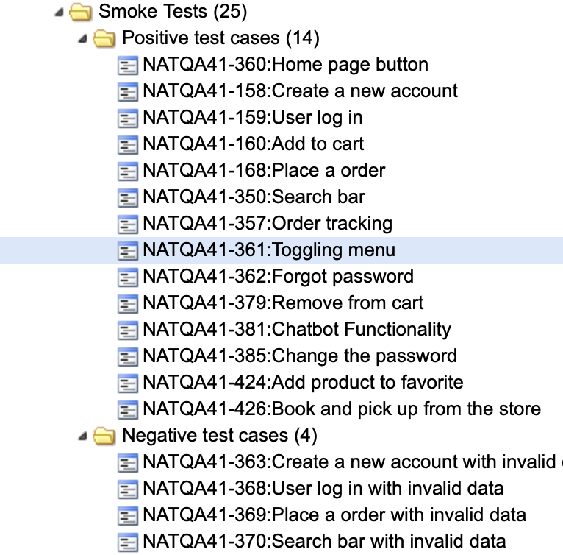
Smoke testing
In an effort to cover the critical functionalities of the web page, I chose to use smoke testing. Using smoke testing, I started with the positive flow and then tried the negative flow as well.

Slide 7
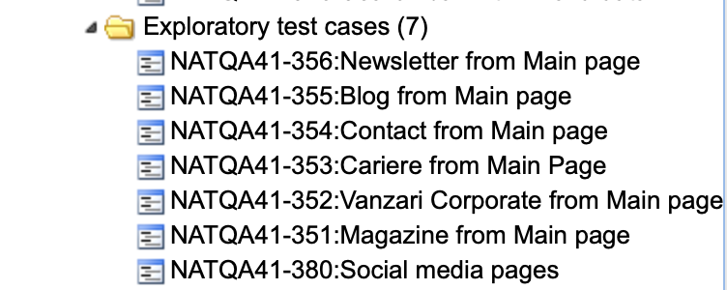
Exploratory testing
Putting myself in the shoes of the end user, I tried to cover as many functionalities of this webpage as possible using exploratory testing.

Slide 8
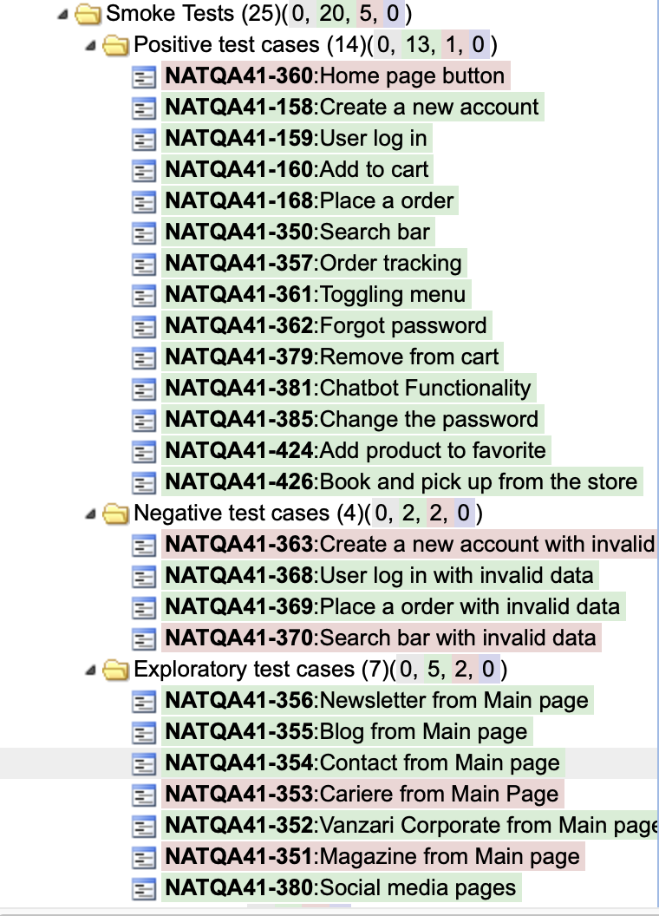
Smoke and Exploratory testing results
Test Results:
Total number of tests executed: 25
Total number of passed tests: 20
Total number of failed tests: 5
Total number of tests with issues: 0
Out of the tests with issues, there were 5 that failed:
1 test from positive testing
2 tests from negative testing
2 tests from exploratory testing

Slide 9
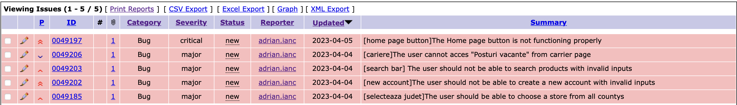
Bugs
For each failed test, a bug report was created in the bug tracking tool (Mantis), with details such as the severity and priority of the issue.

Slide 10
In conclusion
Based on the testing performed, it can be concluded that the Flanco.ro website has some critical issues that need to be addressed. The smoke testing revealed that the basic functionality of the website is working properly. However, the exploratory testing uncovered several usability and functionality issues that could lead to a negative user experience.
The test cases covered both positive and negative scenarios for the critical functionalities of the website. While most of the positive test cases were passed, there were several negative test cases that failed, indicating that there are potential vulnerabilities in the system. The exploratory testing helped to uncover additional issues that were not covered by the test cases.
Overall, the bug report identified a total of 5 bugs, all of which were of high severity and priority. These issues need to be addressed in order to improve the user experience and maintain the integrity of the website.
In conclusion, while the website is functional, there are several critical issues that need to be addressed. It is recommended that further testing be conducted to ensure that all issues are identified and addressed.

Slide 11
Leson learned
Before starting any testing project, it's important to have a clear plan and strategy.
Time management is crucial in testing, as testing deadlines can often be tight. It's important to prioritize tasks and allocate sufficient time for each one.
Using a combination of testing techniques can help ensure that all aspects of the application are tested enough.
Any application, whether it has 50 000 users per minute or 10 per week, still has bugs.

Slide 12
Thank you for your time!

